Slide 1

EIOM
Emergency Information on Mobile

Slide 2

Emergency Information on Mobile
Application on a mobile device
Runs on Android OS
Provides the contact information or phone numbers of the nearest help place
Provides a map
Offline mode in case of lost internet connection
○collects name, contract number, address
○update collected data automatically

Slide 3
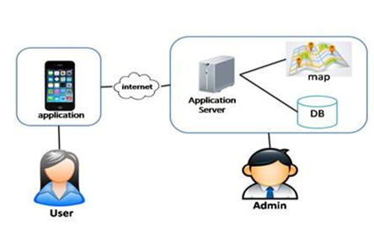
Two parts
●Mobile part for the user
●Server part for the admin
●The user uses the application
and internet to connect with the application server
●The admin manages the the help data
and updates the data to the application server

Slide 4
Server Part
Feature 5: Manage Information System
Emergency Information on Mobile

Slide 5
URS & SRS
User Requirement Specification : consist of 3 URS
System Requirement Specification: consist of 6 SRS

Slide 6
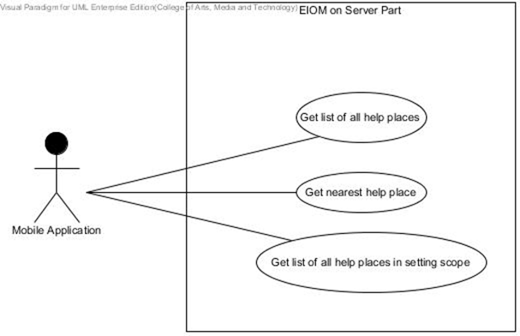
Use Case Diagram

Slide 7
User Requirement Specification
URS-18: The mobile application can get list of help places where locate in the setting scope.
SRS-67: The system shall retrieve list of help places where locate in the setting scope from the database.
SRS-68: The system shall show list of help places where locate in setting scope in form of JSON.

Slide 8
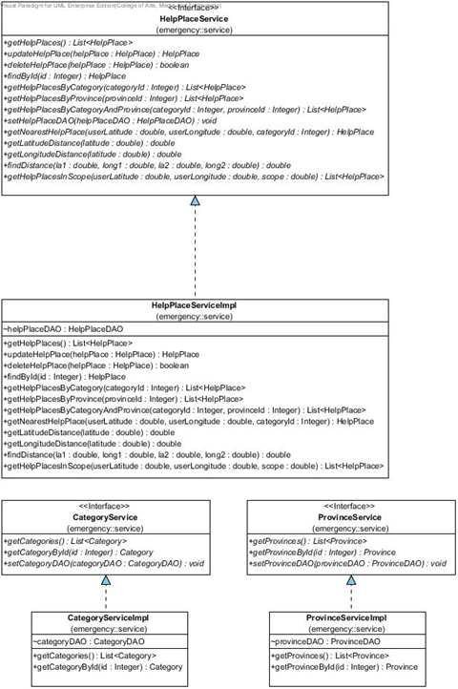
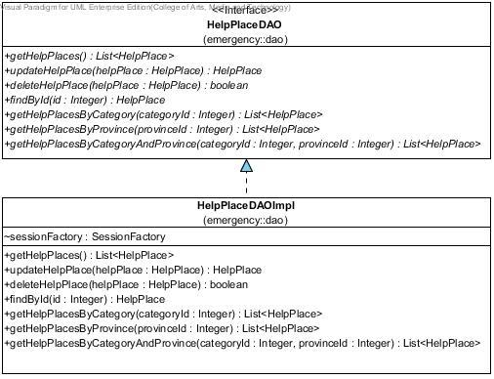
Class Diagram

Slide 9
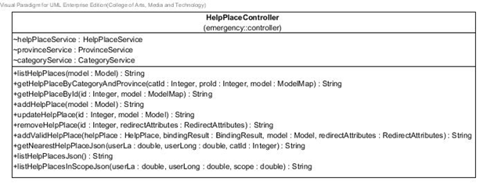
Class Diagram

Slide 10
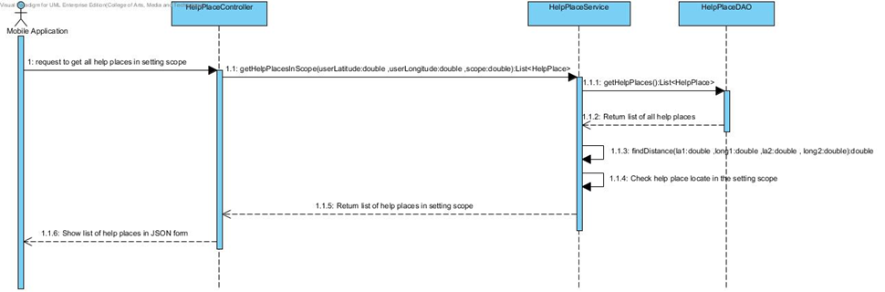
Sequence Diagram

Slide 11
Unit Test Case
Unit Test Case 13 (UTC-13): getHelpPlacesInScope(double userLatitude, double userLongitude, double scope):List<HelpPlace>
Case | Description | Input |  |  | Expected Result
 |  | User’s latitude | User’s longitude | Scope(meter) | List of help place object
 |  |  |  |  | ID
1 | Test get help places by input scope which have help place locate | 18.789643 | 98.969758 | 1000 | 1
2 | Test get help places by input scope which have help place locate | 18.789643 | 98.969758 | 4000 | 1,2
3 | Test get help places by input scope which does not have help place locate | 18.789643 | 98.969758 | 1 | Empty List

Slide 12
Test Record
Unit Test Case 13 (UTC-13): getHelpPlacesInScope(double userLatitude, double userLongitude, double scope):List<HelpPlace>
Case | Description | Expected Result | Actual Result | Pass/Fail
 |  | List of help place object | List of help place object
 |  | ID | ID
1 | Test get help places by input scope which have help place locate | 1 | 1 | Pass
2 | Test get help places by input scope which have help place locate | 1,2 | 1,2 | Pass
3 | Test get help places by input scope which does not have help place locate | Empty List | Empty List | Pass

Slide 13
User Interface
Server Part

Slide 14
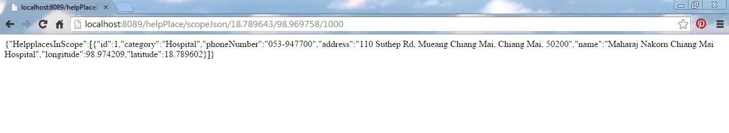
JSON

Slide 15
Mobile Part
Feature 2: Search information system
Feature 4: Automatic collecting data system
Emergency Information on Mobile

Slide 16
URS & SRS
Feature 2: Search information system
consist of 2 URS, consist of 13 SRS
Feature 4: Automatic collecting data system
consist of 2 URS, consist of 8 SRS

Slide 17
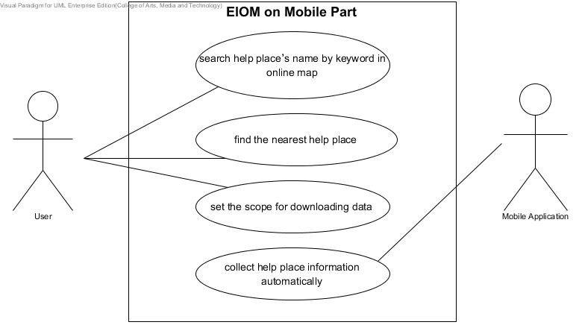
Use Case Diagram

Slide 18
User Requirement Specification
URS-19: The user can search help place’s name by keyword in online map.
SRS-69: The system shall provide search button UI.
SRS-70: The system shall provide text field UI.
SRS-71: The system shall receive all help places from server.
SRS-72: The system shall search help places by keyword from user inputting.

Slide 19
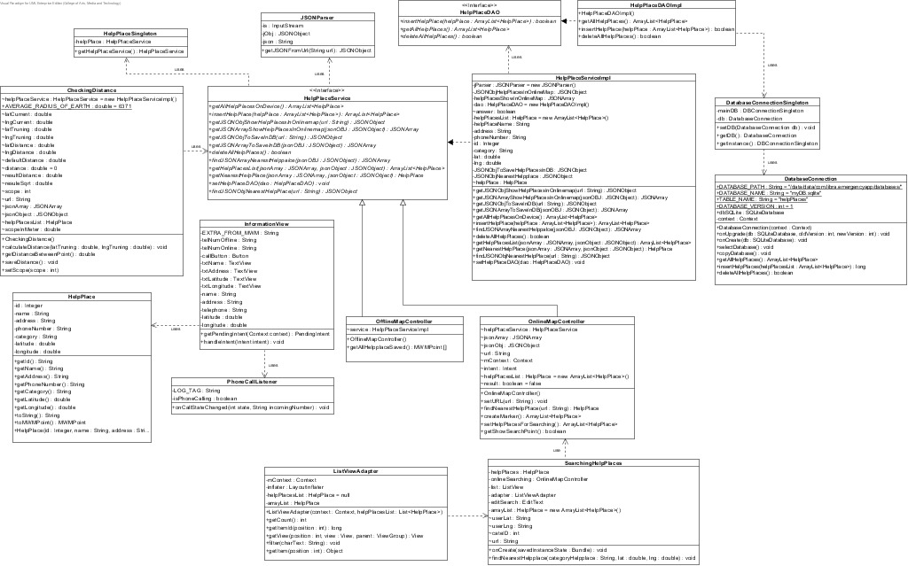
Class Diagram
1
2
3
4

Slide 20
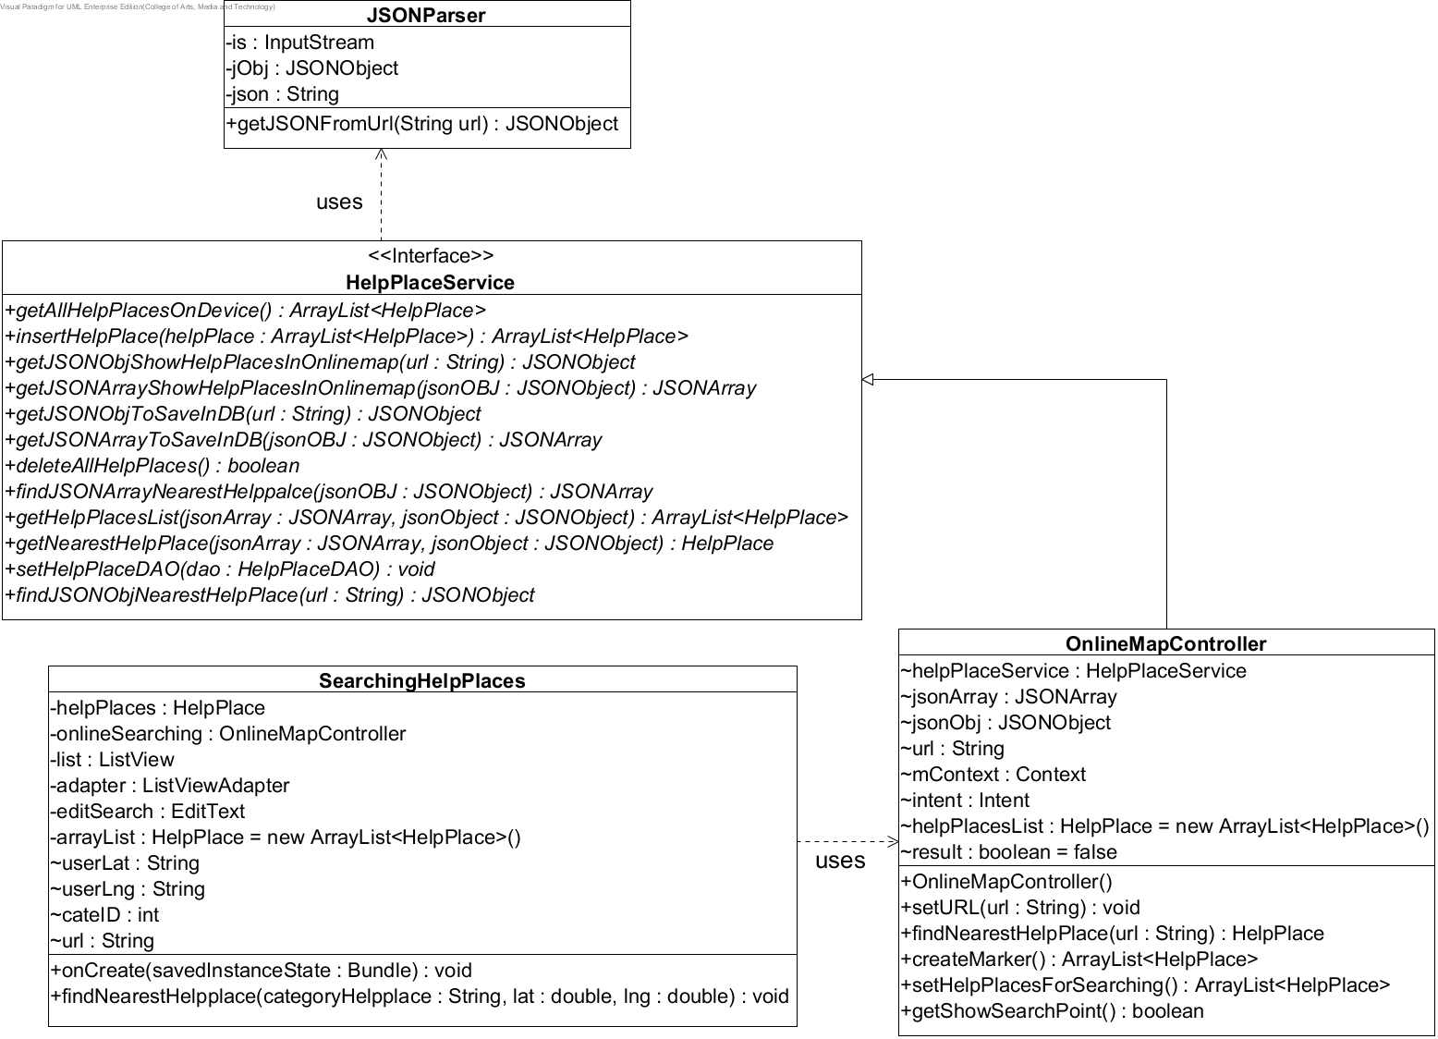
Class Diagram

Slide 21
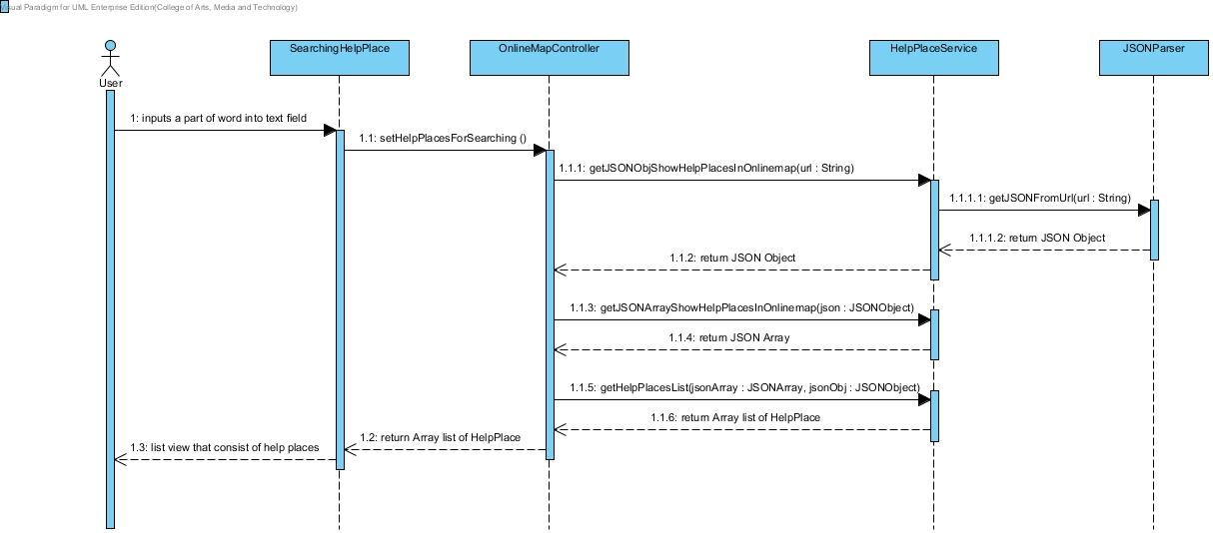
Sequence Diagram

Slide 22
Unit Test Case
Unit Test Case 17 (UTC-17): insertHelpPlace(ArrayList <HelpPlace> helpPlace): int
Class name: HelpPlaceServiceImplTest
Case | Description | Input | Expected Result
 |  | List of Help Places ID | List of Help Places ID
1 | Test insert array list of help places into database | 1,2,3,4,5 | 1,2,3,4,5
2 | Test insert array list of help places are not null | 1,2,3,4,5 | Not null

Slide 23
Test Record
Unit Test Case 17 (UTC-17): insertHelpPlace(ArrayList <HelpPlace> helpPlace): int
Case | Description | Expected Result | Actual Result | Pass/Fail
 |  | List of Help Places ID | List of Help Places ID
1 | Test insert array list of help places into database | 1,2,3,4,5 | 1,2,3,4,5 | Pass
2 | Test insert array list of help places are not null | 1,2,3,4,5 | Not null | Pass

Slide 24
User Interface
Mobile Part

Slide 25
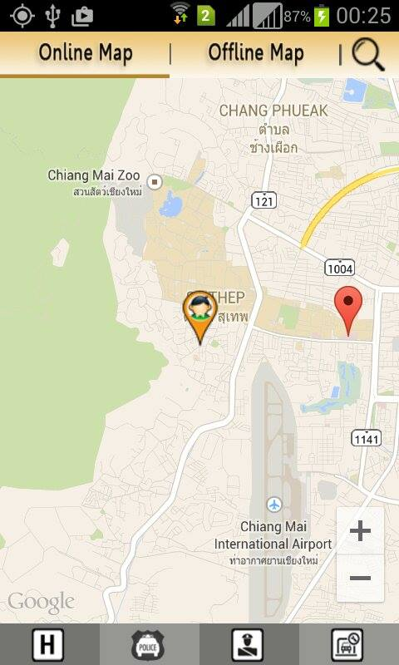
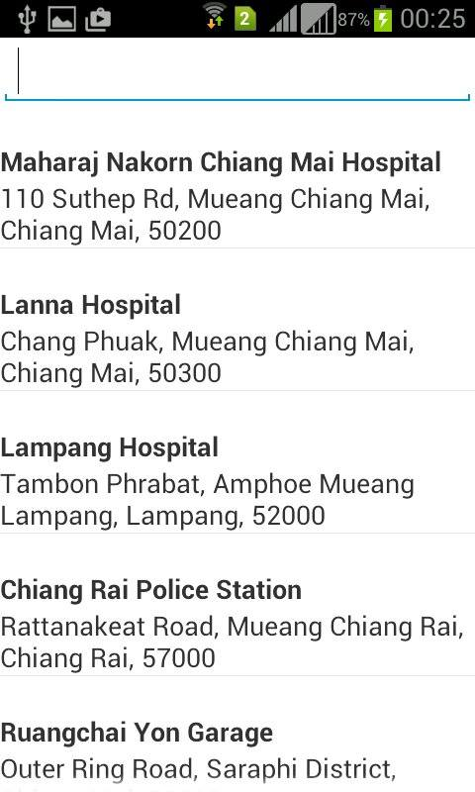
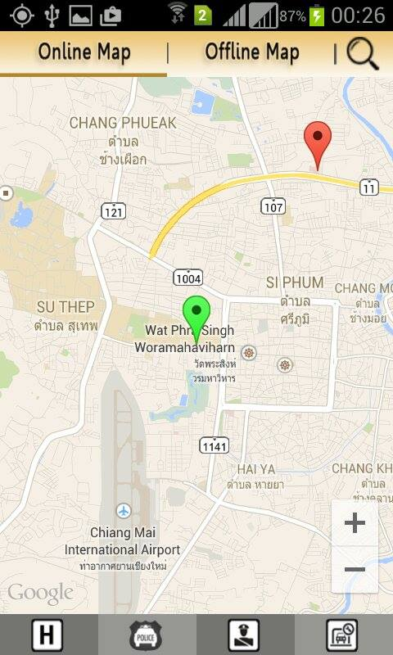
Search Help places

Slide 26
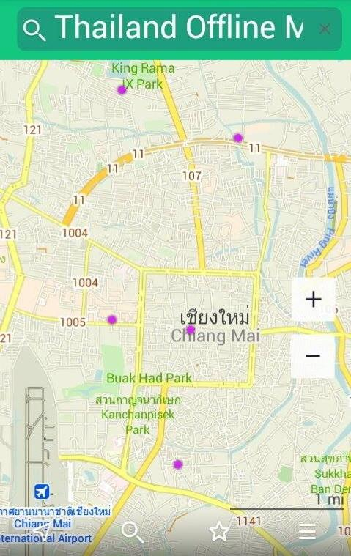
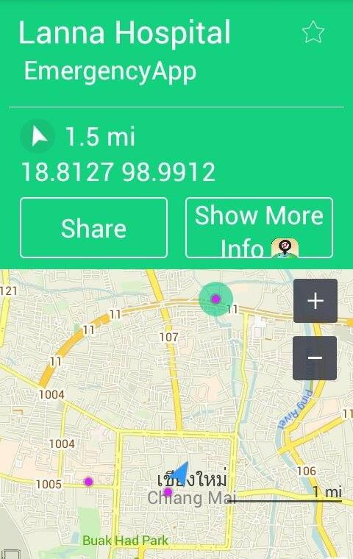
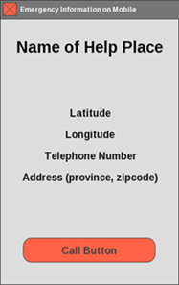
Show Offline Map

Slide 27
DEMO PROGRAM & UNIT TEST
Emergency Information on Mobile

Slide 28
Problem & Solution
• Solution
- Prefer change request to member in team and advisor
- Recondition some problem and get help from friend or advisor who knows about the server
• Problem
- Some method cannot working with feature in progress 2 (Method change request)
- The connection to the server

Slide 29
Q/A
Emergency Information on Mobile

